Slide 1


Scouting with AI
Tom Callegari
UNIVERSITY of TORONTO
SCHOOL of CONTINUING STUDIES
Data Analytics Bootcamp
2019

Slide 2

INTRODUCTION
“It’s not a science, it’s definitely an art.”
Kevin Cheveldayoff, Winnipeg Jets GM
“The hardest part is the judging truly doesn’t come for years to come. The big thing about the draft is it’s all based on projections. It’s the ability to project and show some blind faith on players that show some attributes that you think can be developed. ”
What is the NHL Draft?
What players are eligible?
Why is it important?
Why scout with data and AI?

Slide 3


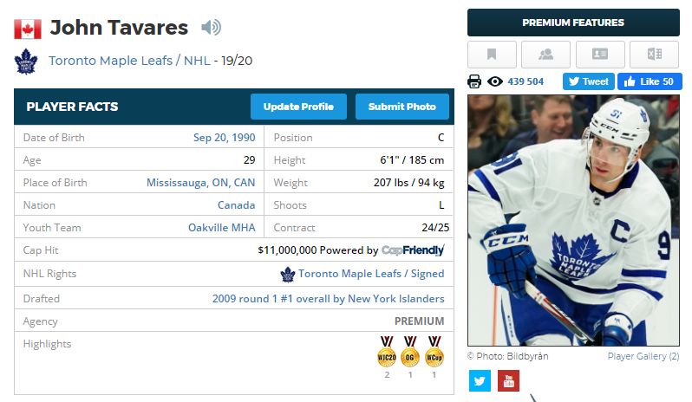


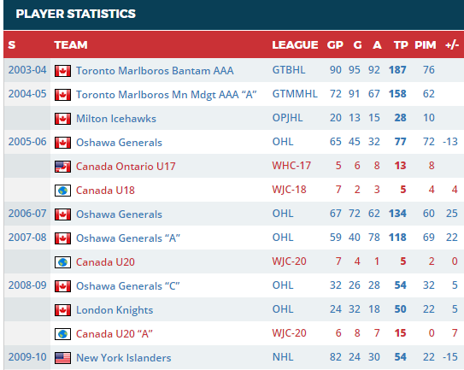


Meta
PROBLEM BREAKDOWN
How do the CHL and NHL relate?
15
16
17
18
19
20
21
22
23
24
25
Age
What data is available?
Player Statistics
To approximate a function for projecting player potential to some point in future time, enough of the “right” data must be collected.
What data can be used?
How should the data be organized?

Slide 4





DATA COLLECTION
&
STORAGE
Web Scraping
Player Profiles URL’s who played in the CHL from 2005-06 to 2017-2018
6054 Player Profiles Pages

Slide 5


Extraction &
Wrangling
Pull from MongoDB
PyMongo
Pandas
By Player Season
Reshape
One Row per Player

Slide 6



Features
Feature Engineering
Response
y $=$ league_25
Refactored
NHL
Lower
Not Active
Variables
Continuous
$X_{i}$ $=$ { age_14 age_17 }
Sentiment Analysis – Scout Text
“Tavares has excellent offensive instincts and has a fantastic ability to find open space in his team's offensive zone. His shot is already on a high level in NHL standards and his stickhandling is phenomenal. Tavares isn't the best skater but he is always explosive after entering the opposing team's zone.”
Natural Language Processing (NLP) Variables
subset
647 x 33
rows
columns

Slide 7




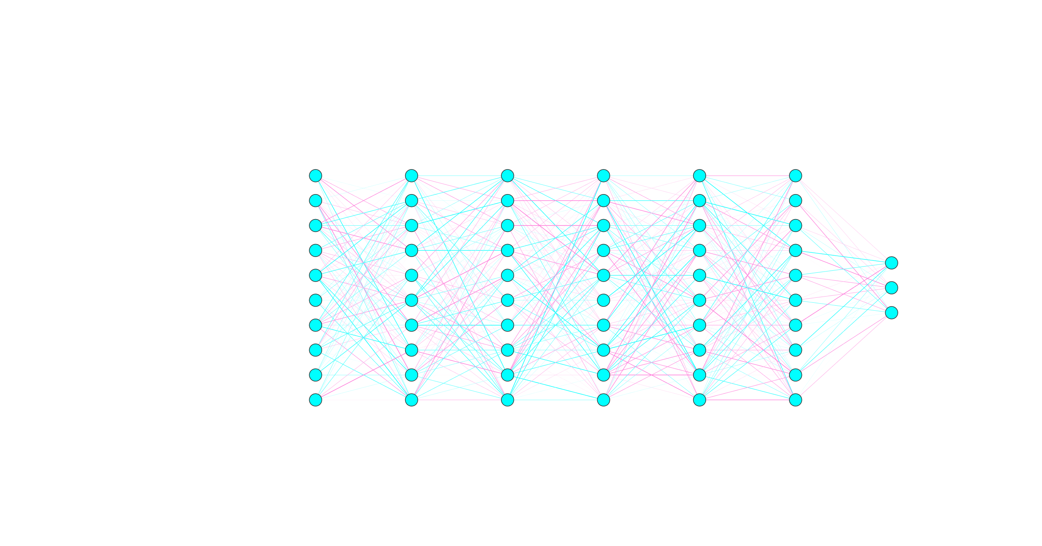
Model
Training
FCFF-NN Architecture
Input layer: 100 units
5 Hidden layers: 1000 units
Output layer: 3 units
70 Epochs

Slide 8

Results
Results
&
Debrief
Debrief
Future Considerations
Cleaner NLP (Names, Misspelling, Hockey Intuition)
Use Scrapy and not BeautifulSoup
Scrape other sites to fill in blank data (hopefully)
Find more scouting blurbs
Data completeness
Psychological data (Family history, Education, Personality Profiles, etc.)
There is quite a bit of noise in the model, some of which could conceivably be explained with quantified mental/psychological data or some useful proxy.

